Slide 1

Visdrone

Slide 2
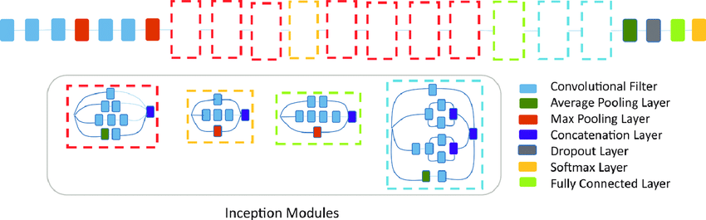
Architectures
InceptionetV3

Slide 3
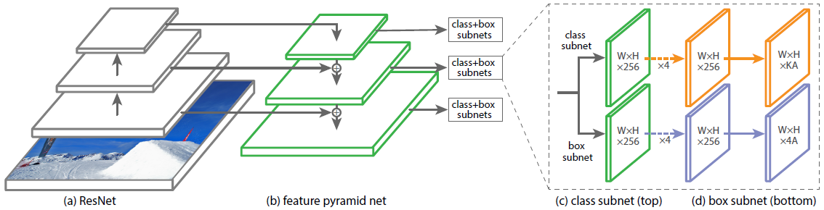
Retinanet

Slide 4
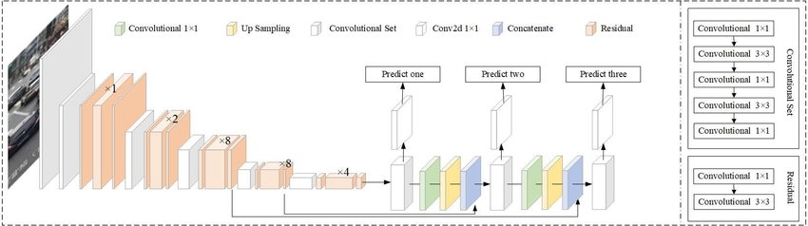
Yolov3

Slide 5
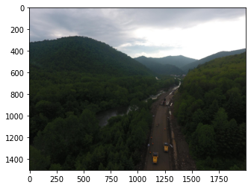
Inception net v3
[('n09468604', 'valley', 0.50206745),
('n09193705', 'alp', 0.023748454),
('n04532670', 'viaduct', 0.022799503)]

Slide 6
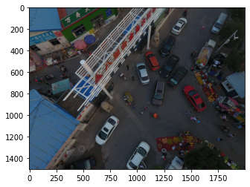
Labels
[('n02930766', 'cab', 0.006438061),
('n03670208', 'limousine', 0.00611805),
('n03796401', 'moving_van', 0.0055998275)]

Slide 7
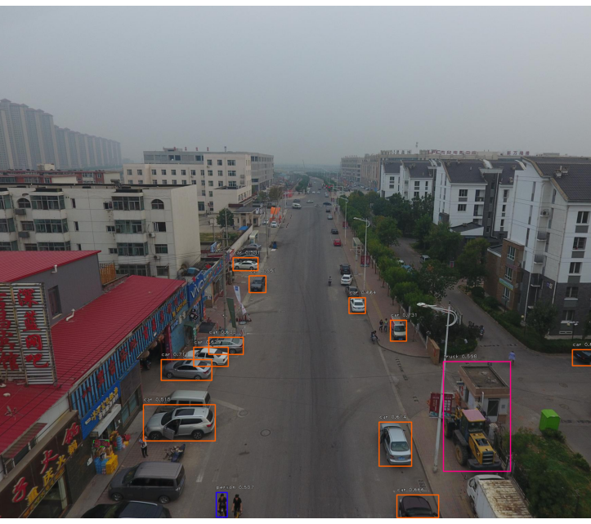
RetinaNet

Slide 8
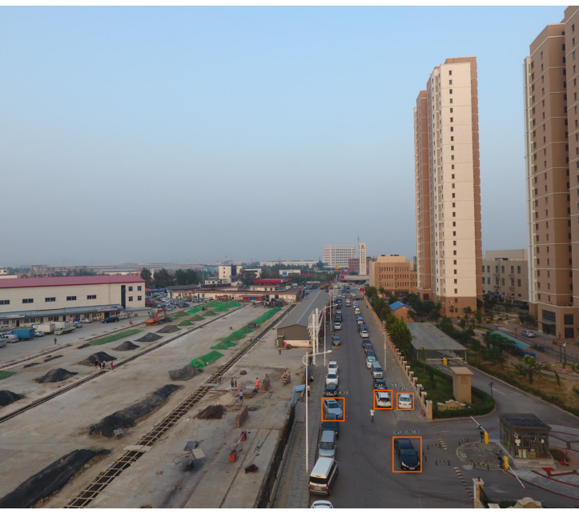
Example

Slide 9
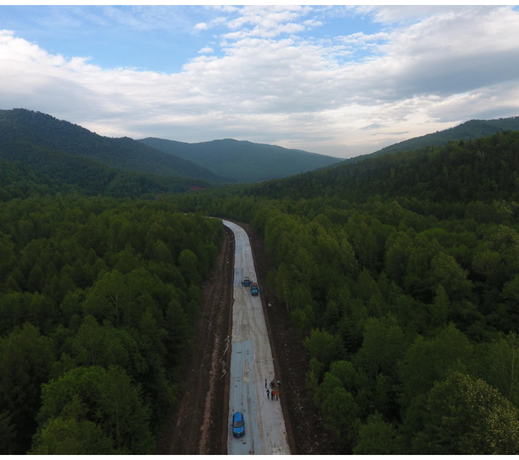
Example 2

Slide 10
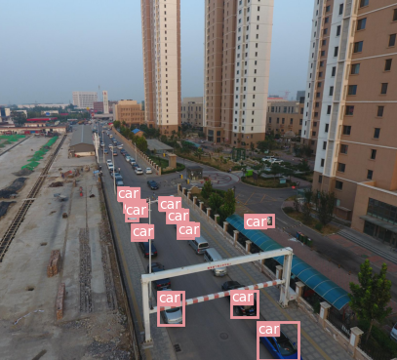
Pytorch Yolov3

Slide 11
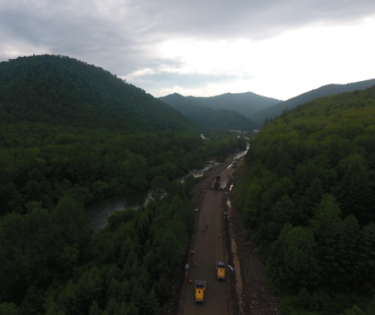

Slide 12
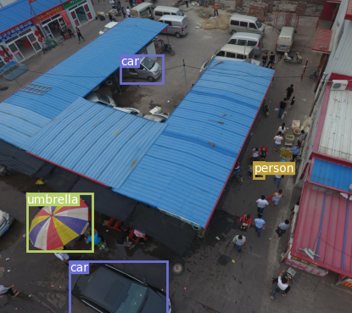
Example 3

Slide 13
Results
Architecture | AP% Score
InceptionV3 | 15
RetinaNet | 20
Yolov3 | 7
Precision measures how accurate is the predictions. i.e. the percentage of the predictions that are correct.

Slide 14
Observations
Accuracy of Yolo v3 is best on small and distinct objects
Retinanet is giving poor performance, works decent on angular views
Inceptionnet v3 works best on the different types of terrains and recognising objects in them

Slide 15
Future Work
Fine tuning of models
Handlabelling of some labels if necessary
Combination of 2 models, one for terrain and one for objects
Training on larger datasets.
Trial on augmented datasets

